Slide 1
Mobile E- Commerce

Slide 2
Abstract
Problem it solves
The dashboard will show you the type of customers visiting the site
The sources that bring the quality customers
By the analysis, we can aim for larger orders, more profitable orders or more frequent orders.
This dashboard captures all of them so you can zero in on which part of the store underperforms.
It compares daily numbers to previous days, weeks and months.

Slide 3
Questions it should answer
Which days of the week have the most purchases?
Which channels bring visitors that actually buy? How profitable are your sales?
How much do visitors typically order?
Are the sales improving over the course of time?

Slide 4

Introduction
Today, the majority of the customers are opting to shop online.
The reasons for choosing this mode of shopping are many like
better offers than offline retail stores, ease of delivery and time
saving. So many sellers now are selling their products online as
E-Commerce is growing big day by day.
E-commerce -- electronic commerce is the buying and selling
of goods and services, or the transmitting of funds or data, over
an electronic network, primarily the internet.

Slide 5

To improve the sales, the seller needs to analyze his website and improve the sales and decision making with the results of analysis. The seller can do the analytics using an analytics tool like Google Analytics.
Google Analytics is a premium web analytics service offered by Google that tracks and reports website traffic. It uses a small piece of Java-script tracking code to collect data about your website visitors and their interactions on your website. Data processing starts with the categorization of data into users and sessions. The reports are made up of dimensions and metrics.

Slide 6

Purpose of the project
To analyse and improve our sales.
To improve site performance.
To increase number of visitors to the site.
To impact the workflow and decision-making processes of the business.
To achieve maximum return of investment

Slide 7
Problems with existing system
The user only knows the products sold and other limited details.
The user cannot have the count of number of visitors to his site.
He cannot track the audience information.
The user cannot analyse the sales. So he cannot improve his decision making skills.
Any error in analyzing the sales can affect the decisions, which in turn bring down the ranking of the exam.
The system cannot handle the vast amount of data which is to be analysed.
The speed of data creation coupled with advantage gained from analysing the data in real time.

Slide 8


Proposed system
Analyzing trends and results of the online
marketing strategy means identifying Key
Performance Indicators (KPI) that measure
constraints required to analyze the sales of the
site. They are:
Number of sessions.
Sessions by web or mobile.
Number of users accessing the website currently.
Number of visited pages.
Visits per page.
Bounce rate.
Events.
Conversations
Average time per visit.
Customers visiting from different countries.

Slide 9
Scope of the project
This project is used to nurture the needs of the
user in the e-commerce sector by embedding all
sales taking place in an e-commerce site.
It will also help optimize the content of the business’s
website based on the user’s interest, which can be
known by measuring the results of the website in
real time, compare the data to previous periods,
and other techniques can also be used.
It will provide both speed and accuracy to business
decisions.
It provides answers to present business problems as well
as give a view of future trends.

Slide 10
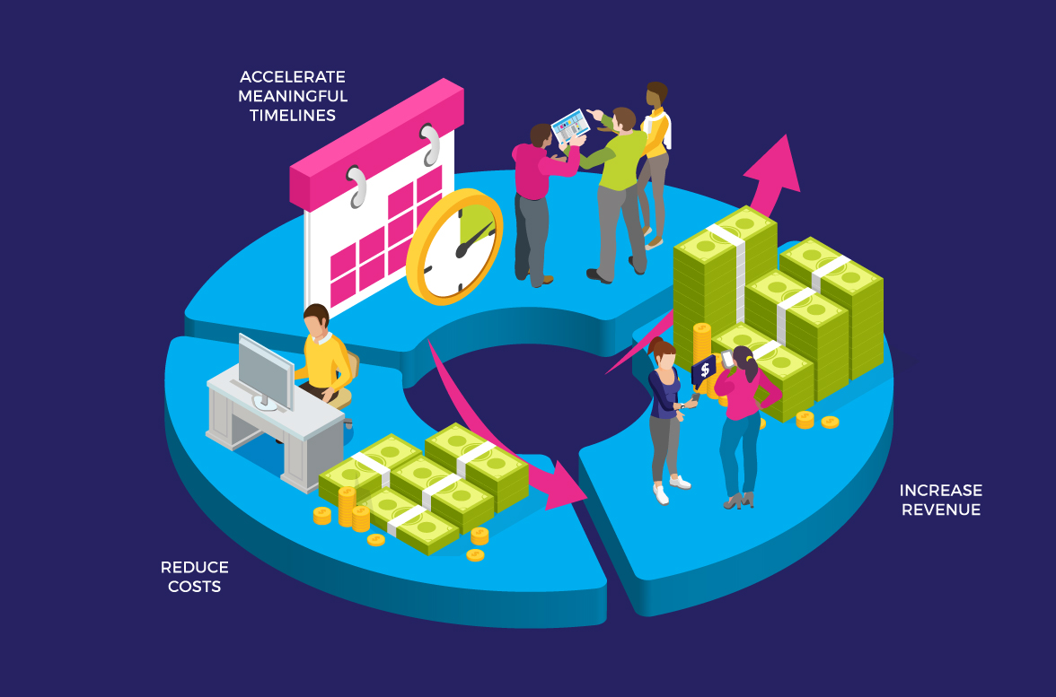
Scope of the project

Slide 11




System Requirements
Software Requirements:
Operating System : Windows, Linux and iOS
Website( Web Application) : Weebly.com
Analytics tool : Google Analytics
Tag Manager : GTM.
Browser : Google Chrome, Mozilla Firefox, Safari, Opera and Internet Explorer.
Scripting Language : JavaScript
Web Tool : HTML,CSS

Slide 12

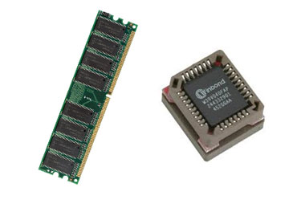
Hardware Requirements:
Processor Required : Intel Pentium or Intel Celeron
Main Memory : 1 GB
Secondary Memory : 100 MB
Cache Memory : 512 KB
RAM : 2GB

Slide 13
Thank You!

